Slide 1
Design specification
Author: Anouchka MINKOUE OBAME - minkoueobamea@gmail.com - Tel:+33 6 58 89 85 31

Slide 2
goals
Goals
1- The idea of ​​design is to show that the user can buy in several stores and pay only once at the end.
2- User can chat in a community of other users. In the community, he can tchat, create groups, post events ..
3- Users can post classifieds of sales between individuals.

Slide 3

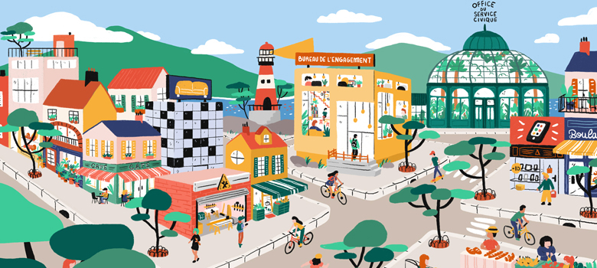
Screen 0
Screen 0-1
Screen 0-2
Où que vous soyez, achetez en une seule fois dans plusieurs magasins de votre choix
Achetez chez vos commerçants locaux

Slide 4


Screen 0
Screen 0-3
Screen 0-4
Sur le réseau social, discutez et partagez avec vos amis
Publiez et trouvez des petites annonces gratuites entre particuliers

Slide 5

Screen 1
Background color of button is: #FD3C12
Put image on background of screen.
When user click on “Se connecter”, screen 2 appears.
minkoueobamea@gmail.com
**********************
Sélectionnez votre département
Connexion
Mot de passe oublié
Inscription

Slide 6
Screen inscription
Background color of button is: #FD3C12
Put image on background of screen.
Formulaire d’inscription
Votre pseudo
minkoueobamea@gmail.com
mot de passe
confirmez votre mot de passe
Inscription
Connexion

Slide 7
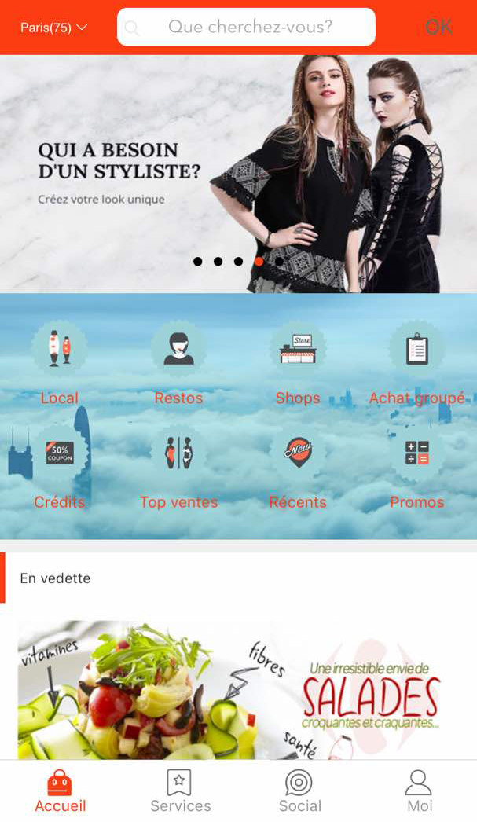
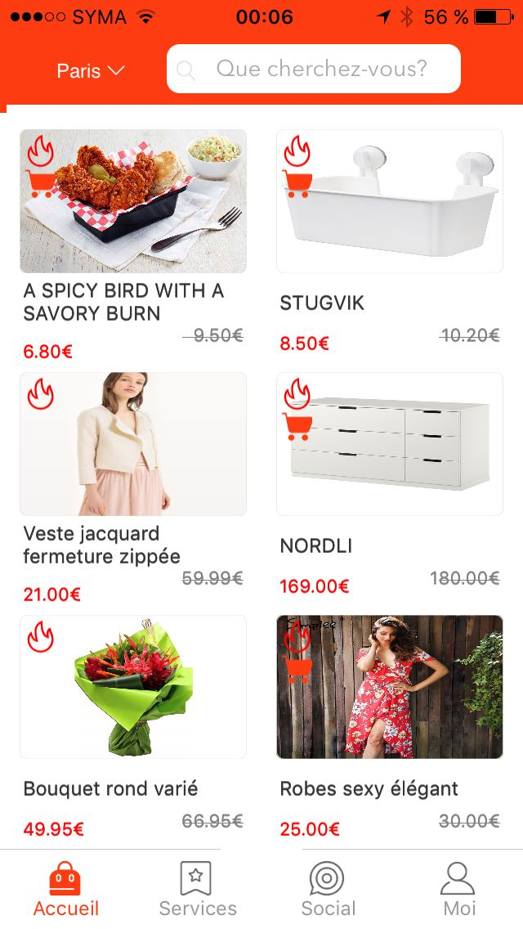
Screen 2
Photo background with a link to a store(pub)
Mode
ITech
Shops
Electro
Restos
Épiceries
Bio
Ventes flash
photo 1
photo 1
photo 1
photo 1
19 €
59€
56 €
150€
19 €
59€
19 €
59€

Slide 8
Screen 2
On screen 2, user can scroll to see these 2 screen.
When user click on “Restos”, screen 3 appears.
Photo background with a link to a store(pub)

Slide 9
Screen 2
It is a search engine that can find stores and products sold in stores.
It is a drop-down list of the different departments of France.
Important:When the user connects, he connects by department, he has access to information by department.In development, the default connection department will be "Seine-Maritime(76)". And there will be 2 departments "Seine-Maritime (76)" and "Paris (75)"
8 photos that scroll horizontally. Put link on photos. You have to put the links on the pictures. Either links to store screens or url links to web pages
Important: The links of the web pages must open in the application.
Mode
ITech
Shops
Main menu. Put this menu block on a white background.
Restos==>Screen 3
Shops ==>Screen 3 but list all the stores of the application located in the department where the user is logged in.
Mode, ITech, Electro, Epiceries, Bio ⇒ Screen 3
Local ==>Screen 3 but list all the stores and restaurants of the application located within a radius of 100 meters.
Electro
Restos
Épiceries
Bio
Ventes flash
Ventes flash
photo 1
photo 1
photo 1
photo 1
19 €
59€
56 €
150€
19 €
59€
19 €
59€

Slide 10
Screen 2
Main menu. Put this menu block on a white background.
Restos==>Screen 3
Shops ==>Screen 3 but list all the stores of the application located in the department where the user is logged in.
Local ==>Screen 3 but list all the stores and restaurants, fast-food... of the application located within a radius of 100 meters.
Mode
ITech
Shops
Electro
Restos
Épiceries
Bio
Ventes flash
photo 1
photo 1
photo 1
photo 1
19 €
59€
56 €
150€
19 €
59€
19 €
59€

Slide 11
Screen 2
These photos are product images of the stores that make promotions / sales / discounts.
On each photo, put a link to the store that sells this product.
icon with a cart => sales with free shipping(do not do)
icon without a cart => sales without free shipping(do not do)
Accueil==>Screen 1
Services==>Screen “Ads between individuals”
Social==>Screens community social network
Moi==>Screen 5

Slide 12
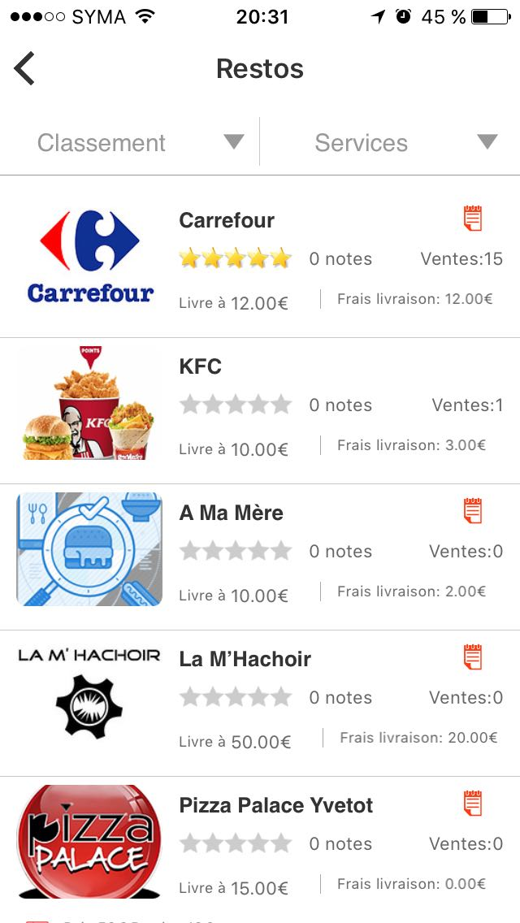
Screen 3(For ‘Restos’)
Rechercher…...
list all the restaurants of the application located in the department where the user is logged in.
When user click on “Pizza Palace Yvetot”, screen 4 appears.
Search engine based on store name, product name ...

Slide 13
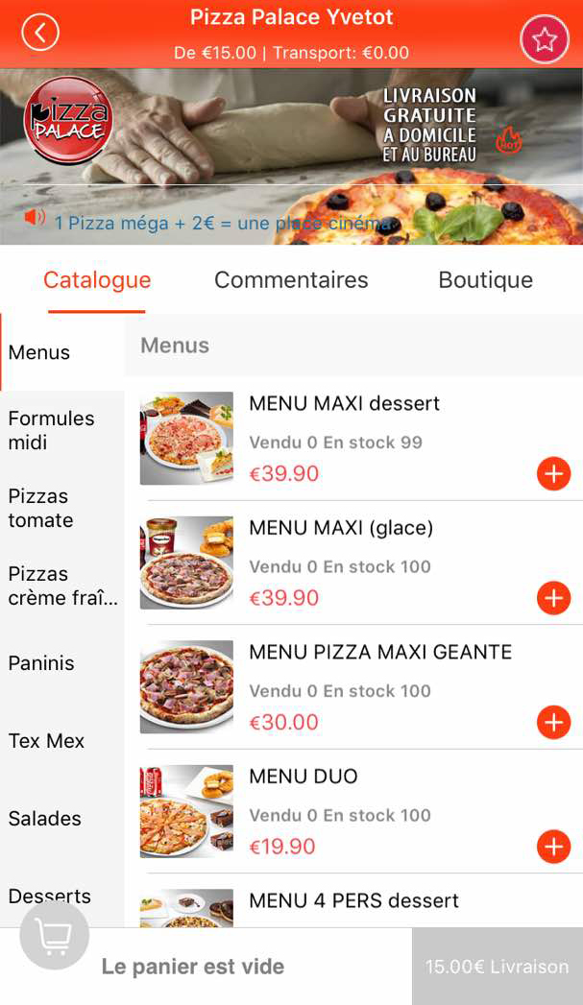
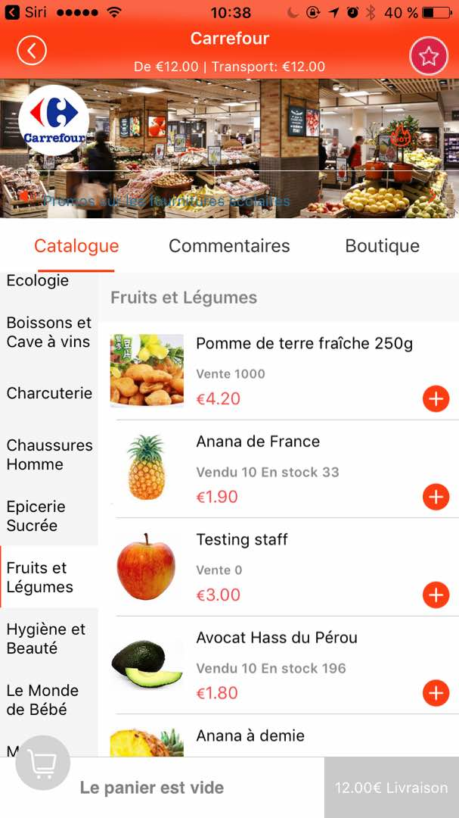
Screen 4
MENUS 1
MENUS 2
Or
MENUS 3
MENUS 4
MENUS 5
MENUS 6

Slide 14
Store categories
(do not do)
Category: Category A
Category: Category B
Background can be : picture, gif or video
Minimum amount to get the delivery and the cost of delivery.
Example: delivery from 12.00 € and shipping cost: 12.00 €
MENUS 1
MENUS 2
MENUS 3
MENUS 4
Here when the user clicks, he adds the shop to his favorites
MENUS 5
MENUS 6
Back button to return to the previous screen

Slide 15
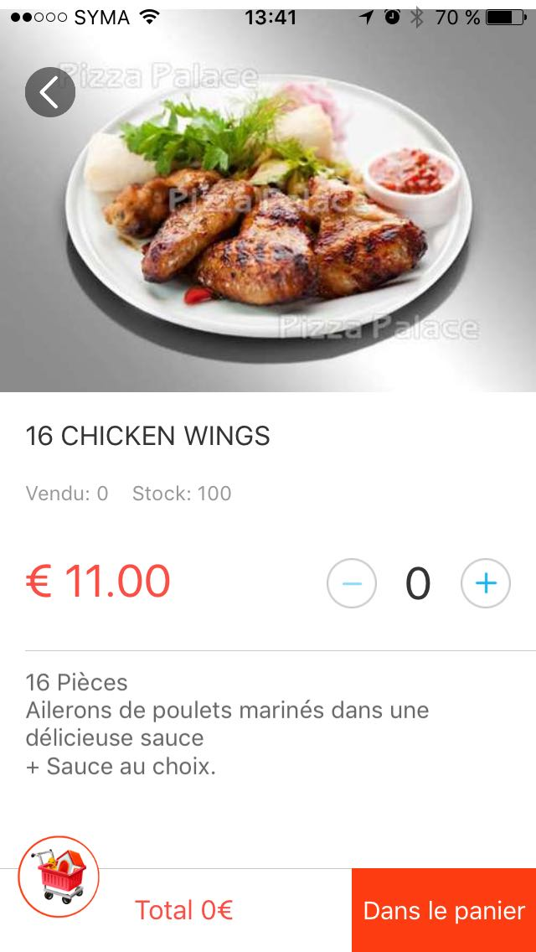
Store categories
Category: Category A

Slide 16
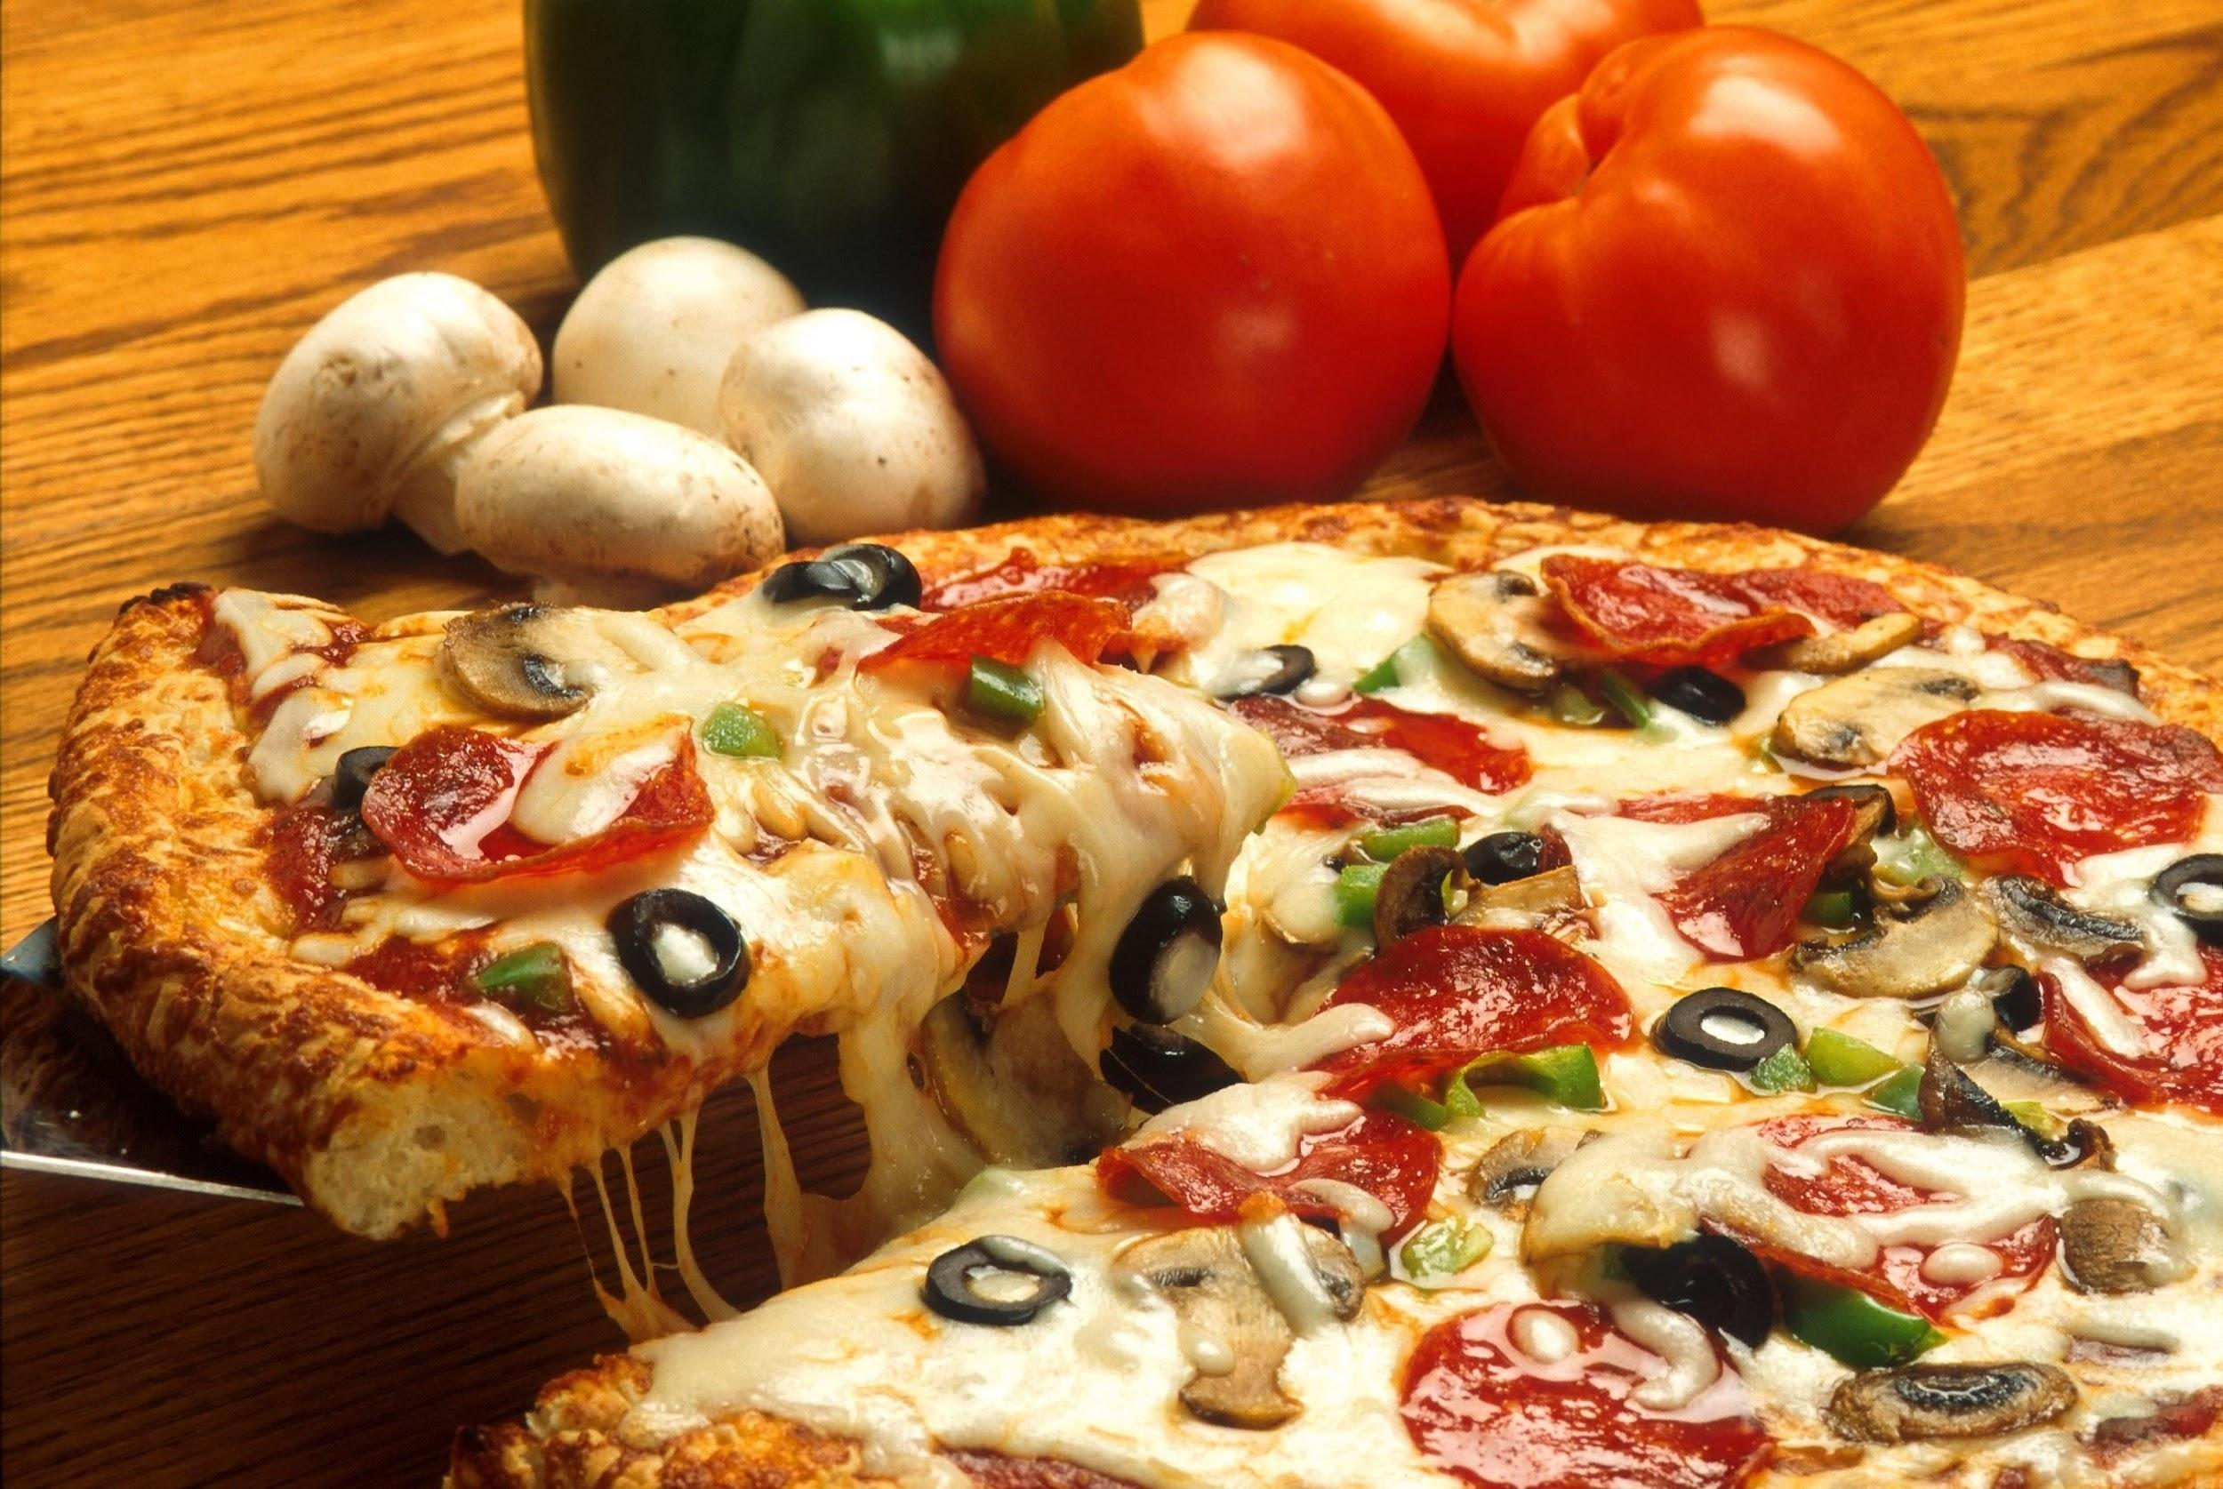
Store categories
Category: Category B
GROUPE(1,2, 3...6...) have many type of produits.
There is a price per type of product.
If for example a user wants 2 juniors, he will click twice on "Junior".
GROUPE 1
GROUPE 2
GROUPE 3
GROUPE 4
Mexicaine
Calzone
Sauce tomate, mozzarella, oignon, merguez, viande hachée
Sauce tomate, mozzarella, oignon, merguez, viande hachée
GROUPE 5
GROUPE 6
Junior: 10,90€
Junior: 10,90€
Senior: 12,90€
Senior: 12,90€
Mega: 19,90€
Mega: 19,90€

Slide 17

Community Social Network

Slide 18
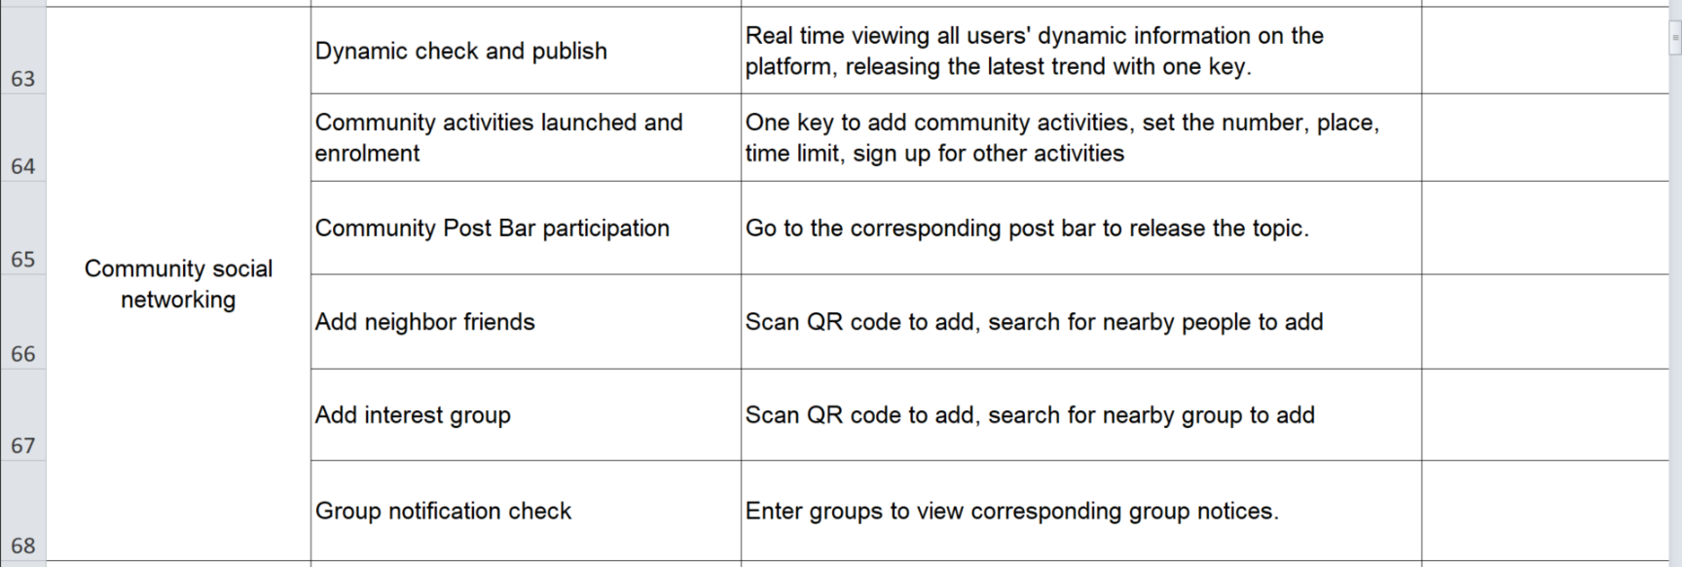
Specifications of Community Social Network
In chats between 2 users or in groups, there will be only exchanges of text messages and possibility of adding images. No audio and video messages for the moment

Slide 19
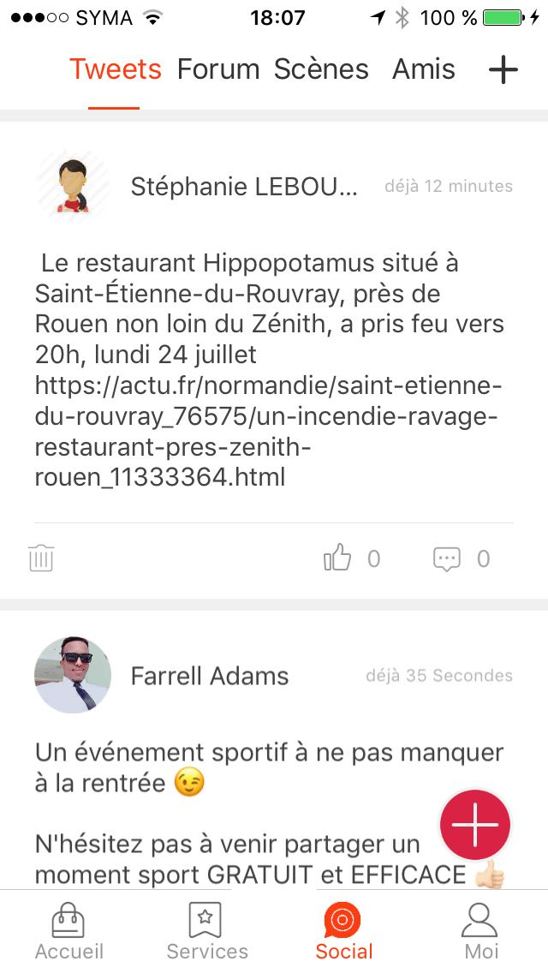
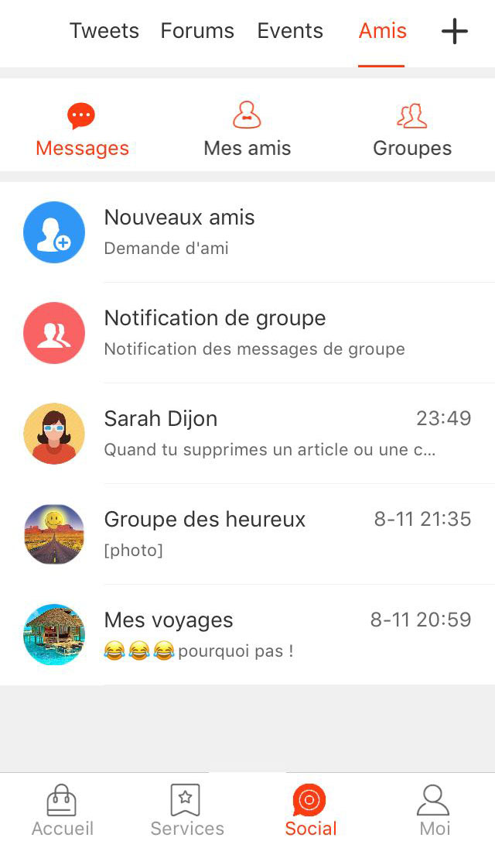
Screen of Community Social Network
Replace the word "Tweets" with "Posts"
Please put this + button to add a post.

Slide 20
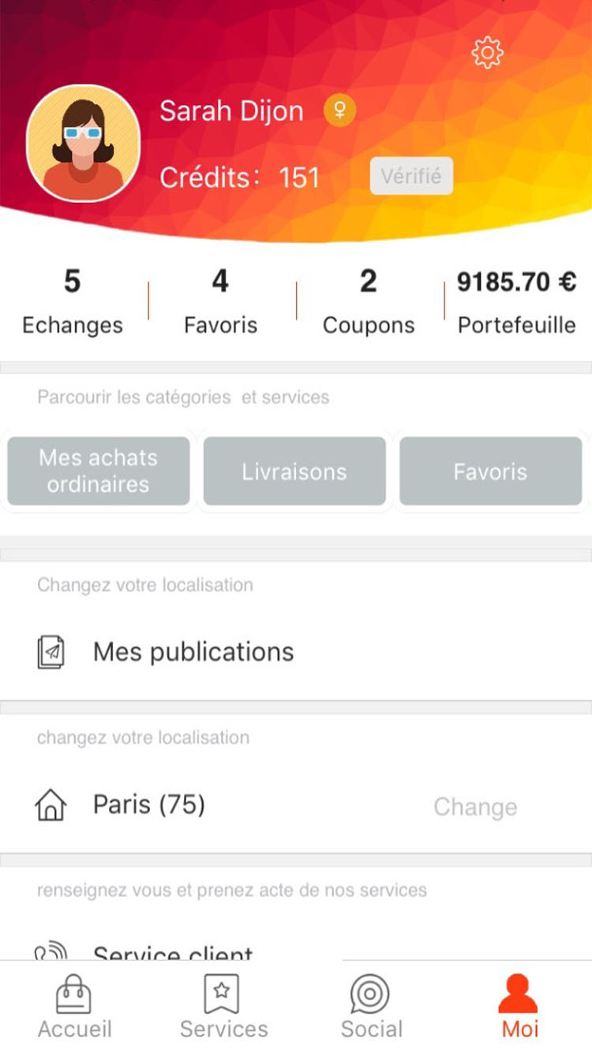
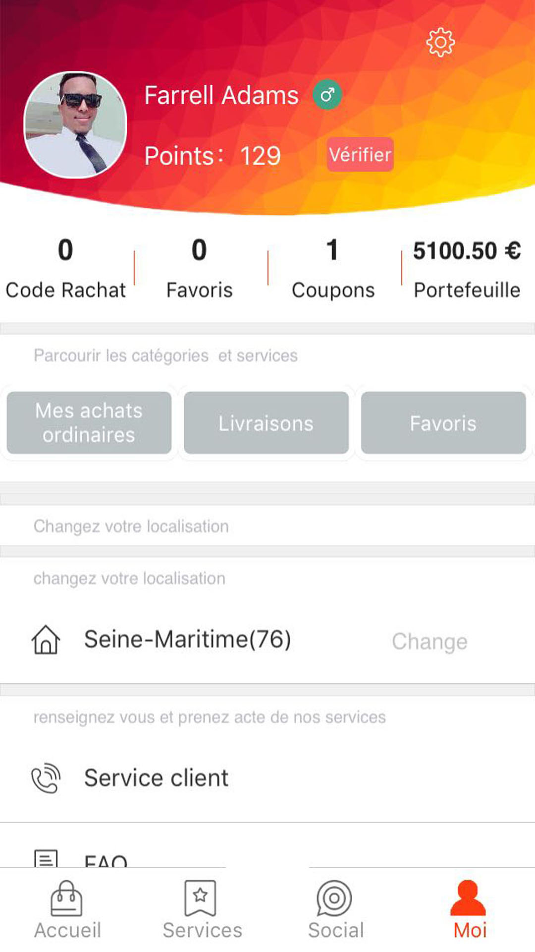
Screen 5
Personal Center
Please remove this part. The red band means you have to remove that part
Panier
Panier

Slide 21
Screen 5
Personal Center
It is a menu sliding horizontally
“Mes achats ordinaires” ===>By clicking on this button, the user accesses its list of purchased products.
“Panier” ===>user access to his cart and can see the products he has selected. From this basket he can validate his order
“Livraisons”==>List the deliveries:
- Deliveries in progress
- Past deliveries
“Favoris” ===> list of stores that user liked
“Bon coin” ===> List items that user post in “Ads between individuals”. Here the user can edit, delete his ads.
Panier

Slide 22
Screen 5
Personal Center
It is a menu sliding vertically.
“Mes publications” ===>List of tweets posted in social network. Here the user can edit, delete his tweets.
“Paris(75)===>indicates that the user is connected in the city of Paris. The user can click on "Change" to change the place of connection.
“Service client”===>Clicking on it will take you to a screen that displays the customer service phone number. And as a customer on this number, it triggers the call.
“Message au service client”===>By clicking on it you access a screen that displays the contact form containing only the message field with the possibility to add attachments.
“Conditions et politique de confidentialité”===> a link to a web page

Slide 23
Screen 5
Personal Center
User accesses his profile and can subsequently modify his profile
Do not put
Panier

Slide 24
Screen to see the profile
Profile
Statut: entrepreneur à succès
Nom: Farrell
Prénom: Adams
Date de naissance: 25/04/2001
Email: Farrell.adams@gmail.com
Tél: 06 58 89 85 31
Adresse: 17 rue de la République,
76190 - Yvetot
Modifier votre profil

Slide 25
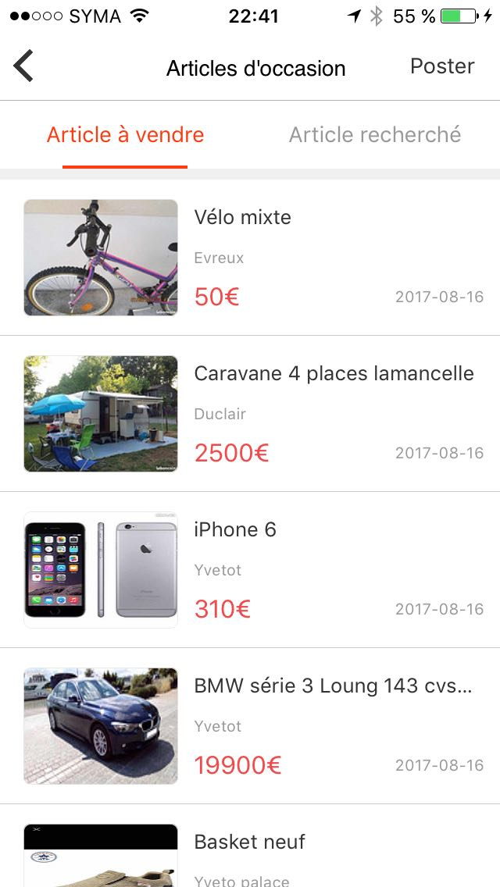
Ads between individuals
Users can post classifieds of sales between individuals.

Slide 26
Ads between individuals
Users can post classifieds of sales between individuals.
List of items that users have put on sale
List of items that users are searching for.
here user accesses the form to post his ad.
At the very beginning of the form, the user must choose whether to sell or search for an item.
Publication date of the ad

Slide 27
Ads between individuals
Vendre
Rechercher
Nom de l’article
Description de l’article
Prix de l’article
Adresse:
N° et nom de rue
Ville
Code postal
Ajouter des photos:
Poster

Slide 28


Ads between individuals
10 pictures that can be scrolled horizontally
Nom du produit
Description du produit
Prix du produit
Adresse du produit
Message
Appel

Slide 29
Admin panel

Slide 30
Admin panel
Admin panel is a web interface.
Admin panel contains 2 accounts:
- Admin
- Manager(all stores)
- Store manager
I would like a very basic admin!

Slide 31
Admin panel
Roles:
Admin | Manager(all store) | Store Manager
- Create/Disable/delete stores. - Add / edit / delete products in stores. - See the list of orders in the different stores - Manage advertising products on the screen 1 - Moderate (Add / Edit / Delete) posts in the social network community as well as in ads - Delete/Desactivate a user - - Create/Disable/delete “manager” and “store manager” | - Add / edit / delete products in stores. - Moderate (Add / Edit / Delete) posts in the social network community as well as in ads | Add / edit / delete products in his store. This user only sees his store, he can not manage the store. He manages that his shop to him.

Slide 32
Store management
Accueil | Ajouter un magasin | Ajouter un groupe de produits | Ajouter un produit à A | Ajouter un produit à B
Ajouter un magasin
Nom
Téléchargez le logo
Téléchargez la photo/gif/video de couverture
Description
Numéro de téléphone
Adresse principale
Nom de la rue
Code postal
Ville
Autres adresses
Nom de la rue
Code postal
Ville
+Autre adresse

Slide 33
Store management
Accueil | Ajouter un magasin | Ajouter un groupe de produits | Ajouter un produit à A | Ajouter un produit à B
Catégories magasins
Types de produits
Habillement/mode
Beauté/santé
Produits culturels
Maison, décoration
Voyages/tourisme
Articles, matériels de sport
Jeux, jouets
Bio
Chaussures
Produits techniques/électroménager
Prix de la livraison
Minimum pour la livraison
Ajouter le magasin

Slide 34
Store management
Accueil | Ajouter un magasin | Ajouter un groupe de produits | Ajouter un produit à A | Ajouter un produit à B
Ajouter un groupe de produits
Sélectionner le magasin
Nom du groupe
Télécharger la photo d’illustration du groupe
Ajouter le groupe

Slide 35
Store management
Accueil | Ajouter un magasin | Ajouter un groupe de produits | Ajouter un produit à A | Ajouter un produit à B
Ajouter un produit dans magasin de catégorie A
Sélectionner le magasin
Sélectionner le groupe de produits
Nom du produit
Description courte du produit
Description longue du produit
Prix promo
Prix vente
Quantité
Ajouter le produit

Slide 36
Store management
Accueil | Ajouter un magasin | Ajouter un groupe | Ajouter un produit à B | Ajouter un produit à B
Ajouter un produit dans magasin de catégorie B
Sélectionner le magasin
Sélectionner le groupe de produits
Nom du produit
Description courte du produit
Description longue du produit
Type de produit/prix
Type
Prix promo
Prix vente
Quantité
Ajouter le produit
+Autre type

